Slide 1

CONVERSION OF SIGN LANGUAGE TO TEXT USING POSE SIMULATOR
By
126004218 Ramana Guhan
126004041 Avinash
126004121 Karthick Raja
Under the Guidance of :
Dr. Raju N

Slide 2
INTRODUCTION
Sign language into text refers to the process of converting hand gestures from sign language, like American Sign Language (ASL), into written text using technology that recognizes the movements and translates them into corresponding words
Sign language is a visual language that uses hand movements, facial expressions, and body language to convey meaning. It is the primary way that people who are deaf or hard of hearing communicate.
Converting sign language into text offers advantages like enabling wider communication between deaf and hearing individuals by bridging the language barrier

Slide 3
LITERATURE SURVEY
TITLE | INFERENCE
Conversion of Sign Language into Text [1] | Sign to text translation is achieved by pre-processing and hand segmentation, feature extraction, sign recognition and sign to text with the help of MATLAB software
Sign language conversion to text and speech [2] | Conversion of sign language to text was achieved by CNN (Convolutional Neural Networks), FRCNN(Faster-Convolutional Neural Networks), YOLO(You Only Look Once) and Media Pipe.
Real-time Conversion of Sign Language to Text and Speech, and vice-versa [3] | Using Convolutional Neural Networks (CNN), image processing, and animation gesture recognition to achieve accurate and efficient translation between sign language and spoken language.

Slide 4
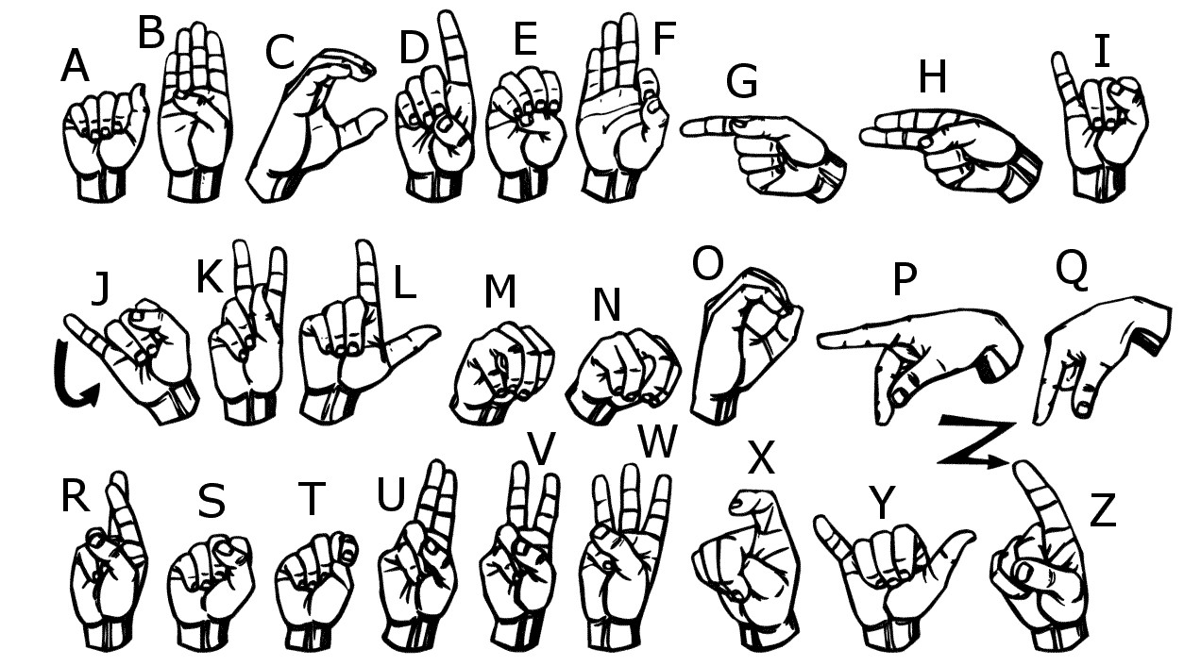
OBJECTIVE
Converting sign language into text using a pose simulator which includes pose estimation, gesture recognition and text conversion.
Enabling effective and efficient communication for the people with hearing and speech impairments.

Slide 5
METHODOLOGY
Hand and Finger Keypoint Detection: Use MM-Pose models to detect hand and finger keypoints for gesture analysis.
Compare Finger Positions to Predefined Values: Compare detected finger positions with predefined values for specific sign language gestures.
Map Gestures to Text: Map recognized gestures to corresponding text characters or words in sign language.
Convert Recognized Gestures into Text: Convert the identified gesture into its text representation for communication.
Display Output on the Screen: Display the recognized text output on the screen in real-time for user interaction.

Slide 6
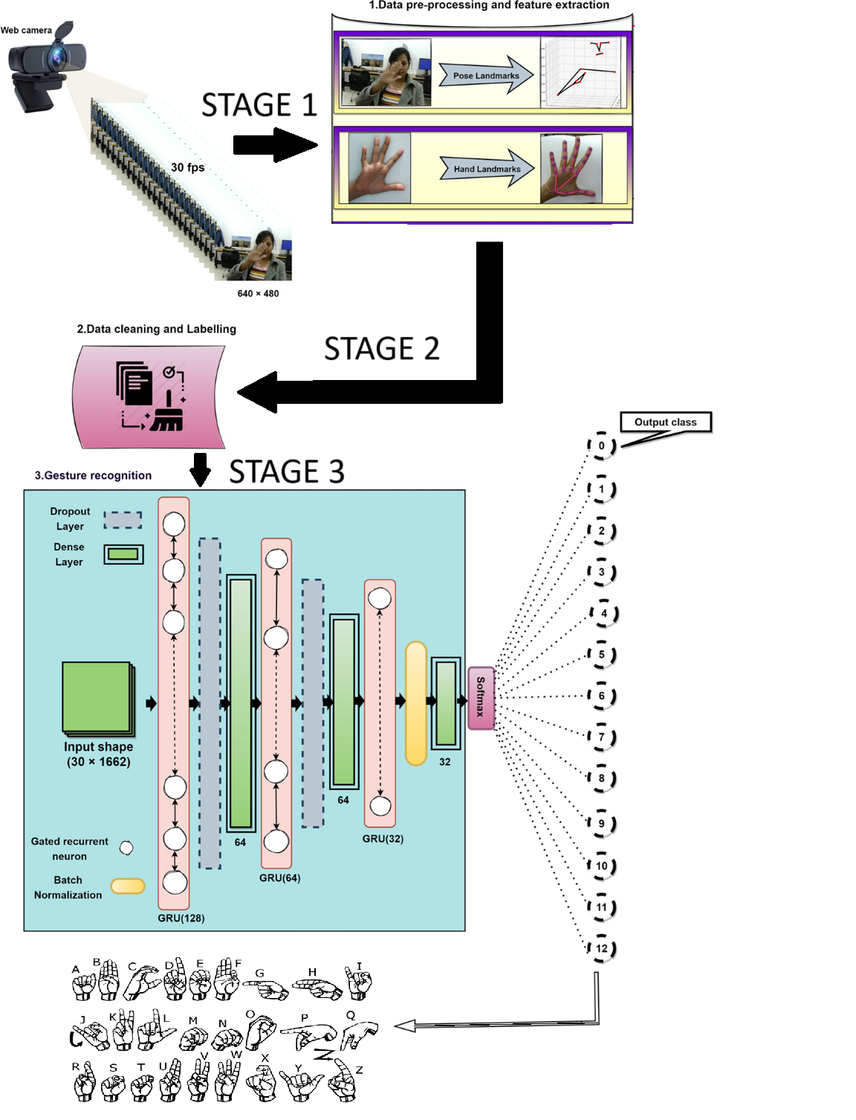
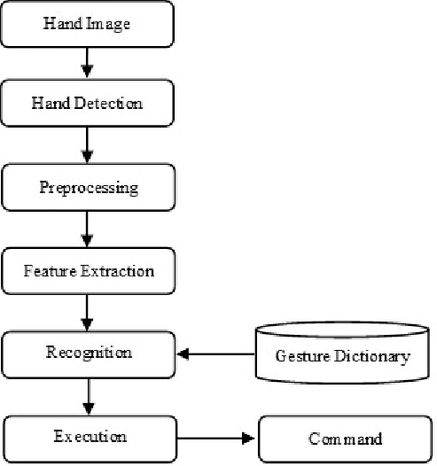
METHODOLOGY

Slide 7
TIMELINE
REVIEW | PLAN
0th Review | Identification of problem statements and exploring the components required
1st Review | Hand gesture capture ,Image processing ,Feature processing
2nd Review | Based on matched gesture, the corresponding word or phrase would be displayed as text.

Slide 8
REFERENCES
Nair, A. V., & Bindu, V. (2013). A review on Indian sign language recognition. International journal of computer applications, 73(22).
Ghotkar, A. S., Khatal, R., Khupase, S., Asati, S., & Hadap, M. (2012, January). Hand gesture recognition for indian sign language. In 2012 International Conference on Computer Communication and Informatics (pp. 1-4). IEEE.
Peng, H. (2015). Application research on face detection technology based on OpenCV in mobile augmented reality. International Journal of Signal Processing, Image Processing and Pattern Recognition, 8(4), 249-256.

Slide 9


